Slide 1
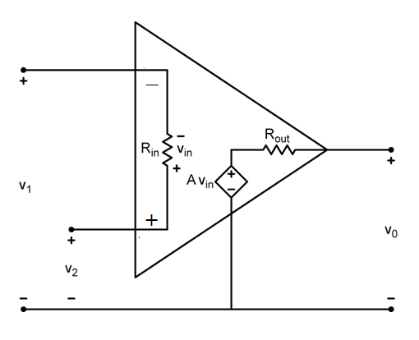
Op Amp: Nearly ideal differential voltage amplifier
Ideal op-amp:
A→ ∞
R_{in}→ ∞
R_{out}→0

Slide 2
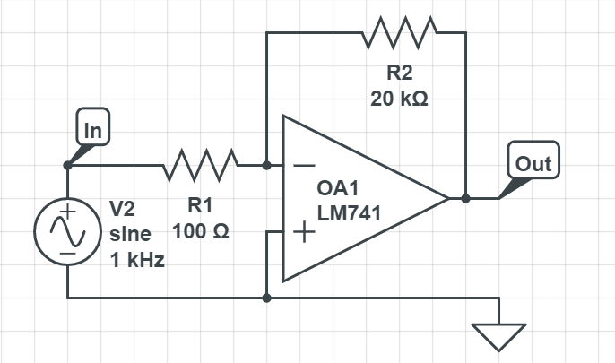
Before you build a circuit, you need to draw circuit diagram, and a wiring diagram
This is a circuit diagram:
Wiring diagram includes the connections specific pins on the chip,
and to the power supplies

Slide 3
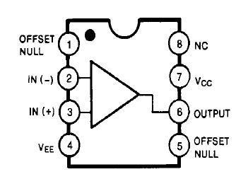
This is a wiring diagram for non-inverting amplifier
V ⁻
V⁺
Input signal
Output
to oscilloscope
R₁
R₂
Ground
Ground

Slide 4
Inverting amplifier
R₂
R₁
v₁
−
+
v_{s}
+
−
+
V_{out}
−
v₂
This amplifier works as designed provided V_{out} is in the range
between V⁻ and V⁺
Clipping of output signal occurs when the amplitude of V_{out} is too high

Slide 5
Summing amplifier
v_{S2}
R _{f}
R₂
− +
v_{S1}
R₁
− +
−
+
+
v_{out}
−
V_{out}= − R_{f} (V_{S1}/R₁+V_{S2}/R₂)

Slide 6
Different pulse shapes can be observed when we add harmonics to sinusoidal signals
clear
t=0:1000;
omega=2*pi/200;
V1=cos(omega*t)-(1/3)*cos(3*omega*t)
+(1/5)*cos(5*omega*t);
figure(1);plot(t,V1)
With large number of harmonics
the output approaches the
square wave

Slide 7
Different pulse shapes can be observed when we add harmonics to sinusoidal signals
clear
t=0:1000;
omega=2*pi/200;
V1=cos(omega*t)+(1/3)*cos(3*omega*t)
+(1/5)*cos(5*omega*t);
figure(1);plot(t,V1)
With large number of harmonics
the output approaches the
triangular wave

Slide 8
All real amplifiers have a finite bandwidths
Bandwidth is the range of frequencies
for which the device works properly
Our OpAmp circuits work well for low frequencies, down to DC
Bandwidth in this case is defined as the frequency
for which the output power gain is down to 50%
of the design value
Important trade off:
Gain * Bandwidth is approximately a constant

